Slide 1
Cogent Lecture 3
Advanced Cogent.
Designing psychological experiments in
MATLAB using Cogent toolboxes
Rebecca Lawson
7th Dec 2017
Course Material: http://www.icn.ucl.ac.uk/
Cogent Software: http://www.vislab.ucl.ac.uk/cogent.php

Slide 2

Autumn/Winter Term – Cogent
2:00pm Thurs 23rd Nov An introduction to Cogent 2000
2:00pm Thurs 30th Nov Logging responses, script logic etc.
2:00pm Thurs 7st Dec Cogent Graphics and external devices
10:00am Mon 4st Dec Practical 1 – Cogent 2000
10:00am Mon 11th Dec Practical 2 – Cogent Graphics
Course Materials
https://www.ucl.ac.uk/icn/study/matlab-course/index

Slide 3
PART A
Preparing and presenting stimuli with Cogent Graphics

Slide 4
Basic script overview: recap
To use Cogent functions just call them from your MATLAB Script
Before you start:
1. set path to include Cogent
2. make rough plan/flow diagram
The script
1. brief description of script(%)
2. define all variables at start
3. create empty or zero variables to store data
Initialising expt. variables
Initialising expt. variables
Configuration of devices
start_cogent
Run experiment
load premade stimulus files
create new stimuli
trial loop:
- present stimuli
- get user responses
- save data as you go
save final data & close files
stop_cogent

Slide 5
Basic script overview: recap
Configure all devices required before you start_cogent
config_display;
config_sound;
config_keyboard;
config_mouse;
config_serial;
config_log;
config_data;
config_results;
To find out more about a config function type: help config_xxx
Initialising expt. variables
Configuration of devices
start_cogent
Run experiment
load premade stimulus files
create new stimuli
trial loop:
- present stimuli
- get user responses
- save data as you go
save final data & close files
stop_cogent

Slide 6
Basic script overview: recap
Start cogent after config_ but before stimuli created/presented
start_cogent
Initialising expt. variables
Configuration of devices
start_cogent
Run experiment
load premade stimulus files
create new stimuli
trial loop:
- present stimuli
- get user responses
- save data as you go
save final data & close files
Stop cogent after all stimuli end, responses logged & data saved
stop_cogent
stop_cogent

Slide 7
Basic script overview: recap
Initialising expt. variables
Configuration of devices
start_cogent
Run experiment
load premade stimulus files
create new stimuli
trial loop:
- present stimuli
- get user responses
- save data as you go
save final data & close files
‘clearkeys’ – clears all keyboard events
‘readkeys’ – reads all keypresses since last ‘clearkeys’
‘[key, time, n]=getkeydown’ – returns keyIDs and times read by last ‘readkeys’
‘[key, time, n]=waitkeydown(dur)’ – waits specified amount of time for keypress
Also: ‘getkeyup’, ‘waitkeyup’ etc.
stop_cogent

Slide 8
Basic script overview: recap
Initialising expt. variables
Configuration of devices
start_cogent
Cogent 2000 commands
Run experiment
load premade stimulus files
create new stimuli
trial loop:
- present stimuli
- get user responses
- save data as you go
save final data & close files
‘preparestring(text, buffer, x, y)’
‘loadpict(filename, buffer, x, y)’
‘loadsound(filename, buffer)’
‘displaypict(buffer)’
‘playsound(filename, buffer)’
‘wait(time)’
‘waituntil(time)’
stop_cogent

Slide 9
Creating & presenting stimuli with Cogent Graphics commands
Today we will look at:
Visual Stimuli: Cogent Graphics
Using sprites
Loading & creating stimuli
Presenting visual stimuli
Sound Stimuli
Loading & creating stimuli
Presenting sound stimuli
Initialising expt. variables
Configuration of devices
start_cogent
Run experiment
load premade stimulus files
create new stimuli
trial loop:
- present stimuli
- get user responses
- save data as you go
save final data & close files
stop_cogent

Slide 10
Creating & presenting stimuli with Cogent Graphics commands
What do I mean by “stimuli”?
Visual Stimuli
Text
Cogent graphics made images
Pre-made (e.g. .bmp)
Matlab made images (arrays)
Movies
Sound Stimuli
Cogent made sounds
Pre-made (e.g. .wav)
Matlab created sounds (arrays)
Initialising expt. variables
Configuration of devices
start_cogent
Run experiment
load premade stimulus files
create new stimuli
trial loop:
- present stimuli
- get user responses
- save data as you go
save final data & close files
stop_cogent

Slide 11
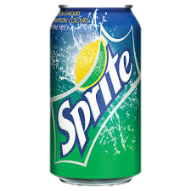
VISUAL: sprites
Sprites are off-screen buffers
Make visual stimuli in advance:
A) load premade stimuli into them (like a bitmap)
B) write or draw in them (using cg commands)
C) load matlab arrays into them (useful if you want to represent images as matrices)
Sprites remain hidden until display
Unique identifier for each sprite (like a buffer)
Sprite #0 represents next screen
Initialising expt. variables
Configuration of devices
start_cogent
Run experiment
load premade stimulus files
create new stimuli
trial loop:
- present stimuli
- get user responses
- save data as you go
save final data & close files
stop_cogent

Slide 12
VISUAL: using sprites
Think of making and using sprites like using powerpoint.
You make sprites (like slides) in advance & present later
 | POWERPOINT | SPRITES in COGENT
Unique ID for each sprite | slide no | spriteno
Create a new sprites | insert new slide | cgmakesprite(spriteno, w,h,col)
Select sprites to draw on | scroll to slide no | cgsetsprite(spriteno)
Draw onto current sprite | insert text box & insert shape | cgtext(str,x,y), cgdraw(x1,y1,x2,x2), ....
Copy sprite onto a new sprite | select new slide, copy & paste original slide | cgsetsprite(spriteno_new) cgdrawsprite(spriteno,x,y)
Present specific sprite | select slide & click slideshow | cgsetsprite(0) cgdrawsprite(spriteno,x,y) cgflip

Slide 13
VISUAL: using sprites
Creating & preparing a sprite:
1. Make an empty sprite
2. Select sprite to draw into
3. Write or draw into the sprite
EXAMPLE: Write blue ‘hello’ in red sprite
spriteno = 1; % sprite no. (>0)
w = 100; h = 40; % sprite size (w*h)
spritecol = [ 1 0 0]; % colour RGB/palette
cgmakesprite(spriteno, w, h, spritecol);
cgsetsprite(spriteno);
cgpencol(0,0,1); cgtext(‘Hello!’,0,0);
Presenting a sprite:
1. Select next screen sprite (0)
2. Draw chosen sprite/s
3. Display next screen
EXAMPLE: Draw sprite#1 centre of screen
spriteno = 1; % sprite no. (>0)
w = 100; h = 40; % sprite scaling (w*h)
x = 0; y = 0; % sprite coordinates
cgsetsprite(0);
cgdrawsprite(spriteno,x,y,w,h);
cgflip;
Hello!
Hello!

Slide 14
VISUAL: presenting stimuli
[tflip] = cgflip(backcol)
Initialising expt. variables
A bit like the ‘drawpict’ command you learned about last week
Refreshes screen with sprite #0
So whatever is in sprite #0 will be displayed on the cgflip command.
INPUT OPTIONS
Set backcolour of new sprite #0
OUTPUTS
Reports time screen refreshed
from start of cogent (seconds!) so you can control the timing of the different parts of your trial.
REMEMBER: You only view what was drawn in sprite 0 after cgflip
Configuration of devices
start_cogent
Run experiment
load premade stimulus files
create new stimuli
trial loop:
- present stimuli
- get user responses
- save data as you go
save final data & close files
stop_cogent
Notes:
Once you’ve made a sprite and drawn some things on to it how do you present it?

Slide 15
VISUAL: using sprites
Why use sprites?
- can create them at start (before trial loop)
- reduce presentation delays
- can draw them:
- multiple times
- into any other sprites
- at different locations
- with different orientation/transparency
- can manipulate their parameters in real-time
cgdrawsprite(spriteno, x, y, w, h) cgrotatesprite(spriteno, x, y, w, h, ang, trans)
- w & h scales the sprite - ang. is angle to rotate by (e.g. 45⁰)
- w < 0 flips sprite horizontally - tras. is transparency (value between
- h < 0 flips sprite vertically 0 and 1)

Slide 16
1. VISUAL: creating stimuli with Cogent
Set line width (pixels) and colour (RGB):
cgpenwid(px) ; cgpencol(col);
cgarc(x,y,w,h,a1,a2,‘a’)
cgdraw(x1, y1, x2, y2)
Hello!
cgarc(x,y,w,h,a1,a2,‘s’)
cgfont(‘Arial’)
cgtext(‘Hello’,x,y,a)
cgrect(x, y, w, h)
cgellipse(x,y,w,h)
cgpolygon(xpt,ypt, x, y)
cgellipse(x,y,w,h, ‘f’)
col = colour as [RGB] or palette index(0-255)
x = object position x axis a = angle
y = object position y axis ‘f’ = filled ellipse
w = object width ‘a’ = arc (outline only)
h = object height ‘s’ = filled segment arc
Notes:
Once you’ve created a sprite (of a certain size etc) you might want to draw/write something on to it. Luckily there is a vast library of cogent graphics commands to enable you to draw anything your heart desires!
You’ve got flexibility over all the attributes you’d expect, like colour, width (like line thickness), orientation, size etc.

Slide 17
example1.m
1. VISUAL: creating stimuli with Cogent
In this script we will:
make a sprite (sprite #1)
We will then draw some ellipses on to it to form the stimulus we want to present.
Next we load sprite #1 on to sprite #0 (remember, sprite #0 is what is presented with the ‘cgflip’ command)
then we present sprite #0 with ‘cgflip’.
1.
2.
3.
‘cgsetsprite(0)’
‘cgdrawsprite(1)’
‘cgflip’
Then:
make a new sprite (sprite #2)
We draw sprite #1 in 4 different locations on sprite #2
we load sprite #2 on to sprite #0
then we present sprite #0 with ‘cgflip’.

Slide 18
2. VISUAL: loading pre-made stim
cgloadbmp(spriteno, fname, w, h) loadpict(fname,spriteno,x,y,w,h)
Initialising expt. variables
INPUT OPTIONS: cgloadbmp
spriteno - sprite to hold image
fname - filename inc. extension
w, h - image scaling dimension (w*h)
X , y - position within sprite (loadpict)
EXAMPLE: Load 10 files named image1, image2, etc into separate sprites (#1-10) and retain original image dimensions.
for spriteno = 1:10;
fname = [ ‘image’ num2str(spriteno) ‘.bmp’ ];
cgloadbmp(spriteno, fname);
end;
Configuration of devices
start_cogent
Run experiment
load premade stimulus files
create new stimuli
trial loop:
- present stimuli
- get user responses
- save data as you go
save final data & close files
stop_cogent

Slide 19
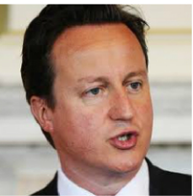

2. VISUAL: loading pre-made stim
example2.m
In this script we will:
make some sprites
Draw some bitmaps onto those sprites
Amend the bitmaps (transparency, size, position)
then we present sprite #0 with ‘cgflip’.
Flexible little sprites!

Slide 20



3. VISUAL: creating stimuli with Matlab
Imagine you want to present a red square to your participant, we’ve already covered two ways to do this with Cogent Graphics.
You could load a bitmap of a red square into a sprite and present it, or you could draw a red square onto the sprite directly using cgrect (x, y, w, h)
There’s a third way! You can use Matlab to create an array of Red, Green and Blue values that’s the same size as the square you want to present and Cogent Graphics can interpret this array as an image and present it.
cgloadarray(spriteno, w, h, array)

Slide 21
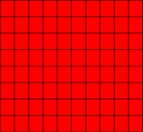

3. VISUAL: creating stimuli with Matlab
example3.m
cgloadarray(spriteno, w, h, array)
EXAMPLE: Generate the illustrated 10 x 10 pixel image & load into sprite #1
spriteno = 1; % sprite no
w = 10; % image width (px)
h = 10; % image height (px)
arrayR = ones(w); % set all red guns to 1
arrayG = zeros(w) ; % set all green guns to 0
arrayB = zeros(w) ; % set all blue guns to 0
array = zeros(h*w, 3) ; % empty array matrix
array = ( [ arrayR(:) arrayB(:) arrayG(:) ] ) ; % 3 column format
cgloadarray(spriteno,w,h,array); % load into sprite 1
cgflip; % present it

Slide 22
3. VISUAL: creating stimuli with Matlab
example3.m
cgloadarray(spriteno, w, h, array)
EXAMPLE: Generate the illustrated 10 x 10 pixel image & load into sprite #1
spriteno = 1; % sprite no
w = 10; % image width (px)
h = 10; % image height (px)
arrayR = randw); % randomly assign red
arrayG = repmat([1:w]/w , [h,1]) ; % columns graduated green
arrayB = eye(w) ; % set 1’s along the diagonal for blue
array = zeros(h*w, 3) ; % empty array matrix
array = ( [ arrayR(:) arrayB(:) arrayG(:) ] ) ; % 3 column format
cgloadarray(spriteno,w,h,array); % load into sprite 1
cgflip; % present it

Slide 23
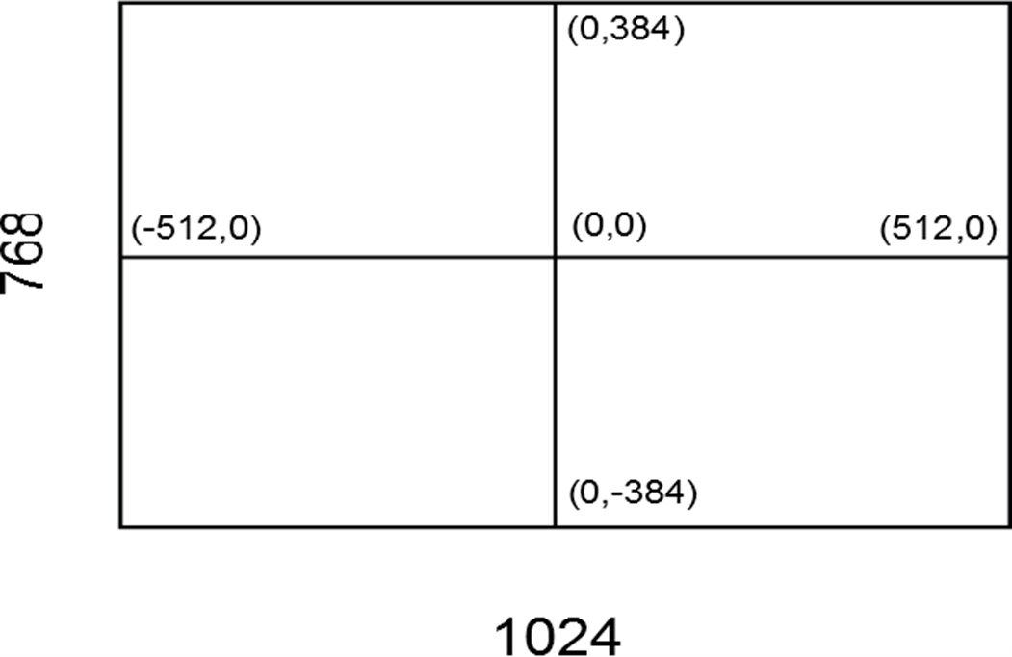
A side note on positioning.
%make a white sprite (#1) full screen
cgmakesprite(1,768,1024,[0,0,0]);
%make a magenta sprite (#2) 100*100 px
cgmakesprite(2,100,100,[1,0,1]);
cgsetsprite(1);%start working with sprite 1
cgdrawsprite(2,-256,192); % top left
cgdrawsprite(2,256,192); % top right
cgdrawsprite(2,-256,-192); % bottom left
cgdrawsprite(2,256,-192); % bottom right
cgdrawsprite(2,-50,0); % top left
cgdrawsprite(2,50,0); % top right
cgdrawsprite(2,0,-50); % bottom left
cgdrawsprite(2,0,50); % bottom right
cgalign(‘horz',‘vert')
horz=[‘l’, ‘c’, ‘r’]’ vert=[‘t’, ‘c’, ‘b’]
Sets the 0,0 coordinate to a specific corner of whatever sprite, bitmap, video you’re currently working with
cgalign(‘b’,’r’);
cgdrawsprite(2);
cgalign(‘b’,’l’);
cgdrawsprite(2);
cgalign(‘t’,’r’);
cgdrawsprite(2);
cgalign(‘t’,’l’);
cgdrawsprite(2);

Slide 24
4. VISUAL: movies
cgloadmovie(spriteno,‘filename.avi’)
cgplaymovie(spriteno,x,y,w,h)
------------------------------------------------------------------------------------------------------
x,y = screen coordinates centred on
w,h = scaling dimensions (-ve value flip like cgdrawsprite)
cgshutmovie(spriteno)
------------------------------------------------------------------------------------------------------
helps to free up memory

Slide 25
4. VISUAL: movies
example4.m
Movie file of a space shuttle launch (‘movie.avi’)
Load into a sprite cgloadmovie(spriteno,‘movie.avi’)
Play the sprite
cgplaymovie(spriteno,x,y,w,h)
Close the sprite
cgshutmovie(spriteno)
Scale and position the sprite
cgalign(‘horz’, ‘vert’);

Slide 26
SOUND: creating & present stimuli
Load & create stimuli
loadsound(‘fname.wav’,buffer)
- Loads a pre-prepared stimulus
preparepuretone(freq,dur,buffer)
freq = pitch of tone (Hz), dur = duration (ms)
Makes a stimulus using cg commands
preparesound(array,buffer)
array = nsamples * nchannels (1=mono, 2=stereo)
- Loads a sinewave made in matlab for use as a stimulus
Present stimuli
playsound(buffer)
loopsound(buffer)
repeats continuously
waitsound(buffer)
waits until sound ended
stopsound(buffer)

Slide 27
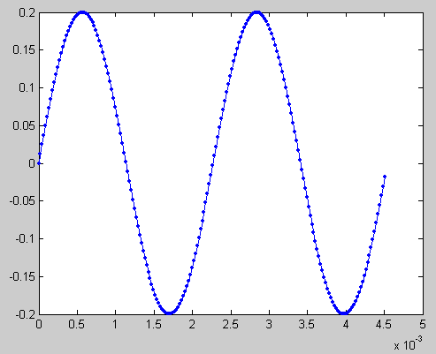
example 5.m
SOUND: creating & present stimuli
Create a 1000 Hz puretone of duration 1s using:
- buffer 1: preparepuretone(freq, buffer, dur)
- buffer 2: MATLAB array sinewave
Basic equation for generating sounds (sinewaves!)
array = a * sin( 2 * pi * freq * t + phase) ; % in radians!
a = amplitude (scale 0-1, effects volume)
freq = tone pitch (Hz)
phase = phase of cycle
t = time(in cycles)
- buffer 3 : .wav file of a puretone
Play each tone 2 times, waiting until end of each.
Display the buffer number being played on screen.

Slide 28

Cogent Graphics in a trial sequence!
Good practice, helps you chunk up the code to keep track of it, helps you ensure accurate timing (important for some studies!)
Prepare 1st stim off screen
For trial=1:p.ntrials;
fix1=cgflip(0,0,0);
+
Prepare 2nd stim off screen
waituntil(fix1+p.fix1_dur);
stim=cgflip(0,0,0);
+
Example!
experiment_cg(‘subid’);
Prepare 3rd stim off screen
waituntil(stim+p.stim_dur);
fix2=cgflip(0,0,0);
+
Prepare 1st stim off screen
waituntil(fix2+p.fix2_dur);
end;

Slide 29
PART B
Cogent & External Devices
(a brief intro)

Slide 30
examples of external device syncing
General Usage:
Receiving triggers from:
Eyetracker
MRI scanner
Check sound or display synchronization
Sending triggers to:
TMS
EEG
Electric Shock Box
serial port ...
Configuration of devices
+ some cogent commands
parallel port ...
Configuration of devices
+ some cogent commands

Slide 31
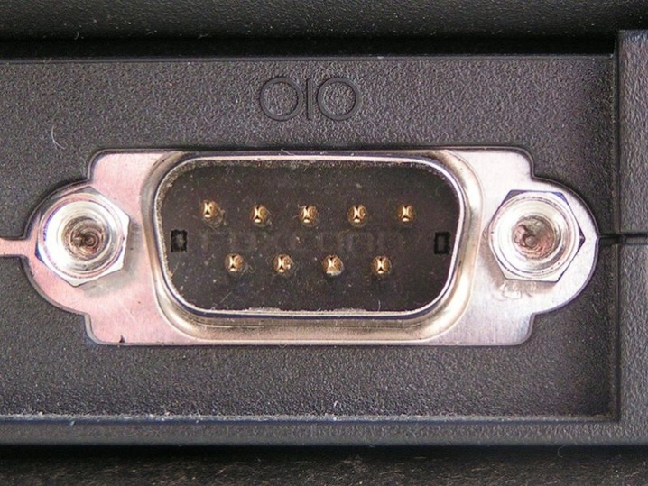
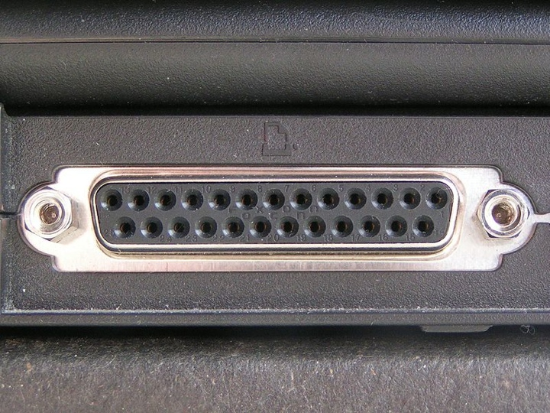
Serial Port
Some old ports on your PC
– still useful for external device synchronisation in experiments
Looks like this!
Both allow computers to communicate with external devices, whether they be a £3million fMRI scanner or humble £30 printers.
Parallel Port
Looks like this!
Notes:
Both interfaces for connecting periperhals to computers

Slide 32
Example: Synchronization Serial Port
with the FIL MRI scanner.
Key code:
config_serial(1); %configs the serial port. Type help config_serial for more info.
[s, time] = waitslice( port, n ) %waits forever for MRI slice n or greater, returns actual slice number and time stamp.
scanport = 1; % scanners are connected to port 1.
config_serial(1);
start_cogent;
if scanner == 1; % if we are connected to a scanner (set this variable above)
[s, time]=waitslice(1,1); %waits for first MRI slice
logstring(time); %log the time that the experiment was triggered
end
for trail = 1:length(ntrials) ;
% prepare your stimulus
% present your stimulus
%log your responses
stop_cogent;

Slide 33
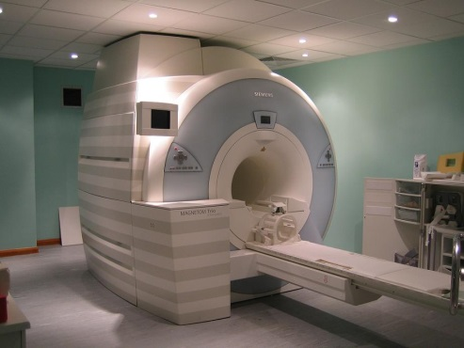
Some more points about MRI scanner synchronisation
Your experiment doesn’t start until the first slice (of brain data) triggers the experiment to start.
This allows you to sync the times that stimuli were presented on the screen with your fMRI timeseries data (log times of events at every cgflip).
Important for accurate analysis of data.
Can also use the triggers from the scanner (slices, or volumes) to control when stimuli are actually presented to the participant:
[slices, times] = getslice( port ) % returns most recent slice number with time stamps.
You can make the next thing that happens in your script (e.g. the next picture that appears) contingent on a certain slice number (or volume number by multiplying nslices by n slices in volume)
Code available here: http://intranet.fil.ion.ucl.ac.uk/pmwiki/pmwiki.php/Main/CognitiveInterface

Slide 34
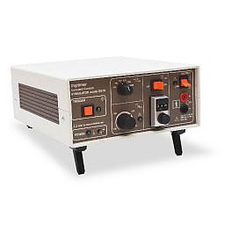
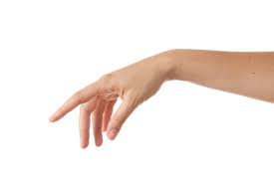

Example: Synchronization Parallel Port
with an Electric Shock Box.
Key Code: outportb(port,num); wait(t_ms); outportb(port,0);
Make a function to trigger the parallel port
e.g.
function givepain
for p=1:1 %Single pulse equivalent to pressing the trigger button
outportb(888,255);
wait(1);
outportb(888,0);
end
Call this function anywhere in the script that you want to deliver an electric shock.
e.g.
if [some condition is fulfilled]
givepain; % trigger the shock box
End;

Slide 35
Getting help!
Inside the ‘Documents’ folder :
CogStdv132.pdf - explanations of commands and examples of cogent 2000 for simple experimental presentation.
G2UsrManv132.pdf - extensive help on cogent graphics commands. Examples, explanations etc.
Previous years slides:
http://www.icn.ucl.ac.uk/courses/MATLAB-Tutorials/

Slide 36
Extra Slides

Slide 37
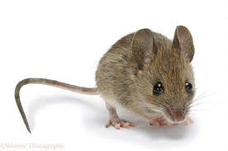
Mouse: configuring and using the mouse
config_mouse (polling mode and unpolling mode, e.g. (10) )
map = getmousemap (creates structure map with variables: X, Y, Z, Button1-4)
readmouse (updates information in map)
x = getmouse (get any of the variables in map)
mouse.m - an example script using the position of the mouse cursor to update the x, y position of some text on screen

